Slide 1
miRNA Logic Gates
PMID 17515909
Notes:
When discussing genetic circuits, we saw many designs involving transcription factors and other proteins. It is also possible to construct genetic circuits using microRNAs in eukaryotes.

Slide 2
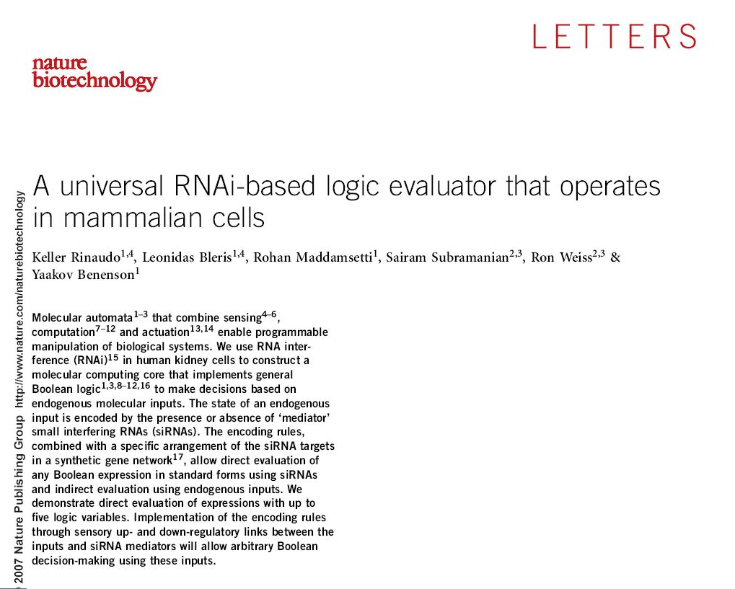
Notes:
This study by Rinaudo et al demonstrates logic gates that operate in mammalian cells based on siRNAs.

Slide 3
Logic gates based on siRNA
If you have a large set of orthogonal inverters, can make scalable logic. It would be nice to have amplifiers too.
You’d use such things to integrate various inputs, do signal integration, and output a singular response
You can imagine doing this with various RNAs or proteins
The authors do this with RNAi, or at least show the basic mechanism of action for doing simple binary logic
Notes:
Logic gates that operate in cells are a popular target for synthetic biology. Mathematically, a large set of orthogonal inverters would be sufficient to form any type of boolean logic. Essentially this would be the biological equivalent of having many transistors operating in the cell. The primary reason for doing this would be to construct signal integrators that merge multiple sensory inputs and respond with appropriate actuation responses. Mechanistically, any chemical strategy in which expression of an RNA or protein controls the expression of another of its own kind could be used in logic gates as long as a large orthogonal set of these biochemicals are accessible. Others have pursued strategies involving recombinases or transcription factors amongst other routes. In this paper, the authors work towards the goal of large integrated genetic circuits using siRNA-based circuits in mammalian cells.

Slide 4
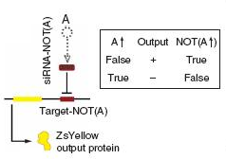
Logic gates based on siRNA
Yellow is a YFP under a constitutive promoter
Recognition sequence for an siRNA on the 3’ end of the YFP transcript
The dotted circle A is some sort of input that gives rise to the expression of the brown box
Brown box is the siRNA
siRNA will knock down the YFP
The inputs are transfected siRNA
Notes:
First let me explain their diagrams. The yellow shape is a yellow fluorescent protein under a constitutive promoter. There is a recognition sequence for an siRNA on the 3’ end of the YFP transcript. Cleavage of this sequence will chop off the poly-A tail inactivating the mRNA.
*
The dotted circle is some sort of input that gives rise to production of the brown box. This Brown box is the guide RNA/RISC complex in the cell.
*
Thus, presence of the A input results in formation of the active complex and knock-down of the YFP gene.
In their experiments, the inputs like ‘A’ are transfected siRNAs.

Slide 5
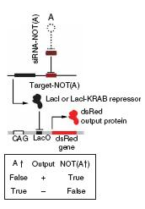
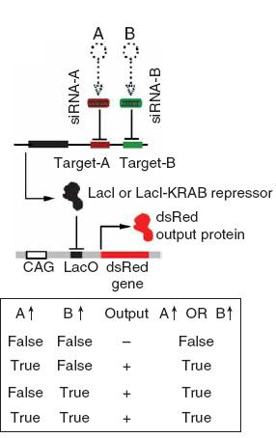
NOT and OR
Notes:
In this circuit, the siRNA controls a LacI gene instead of YFP. LacI then goes on to transcriptionally control an RFP gene. This is ultimately a NOT gate.
*
Here, two siRNAs control the LacI gene resulting in an OR gate.

Slide 6
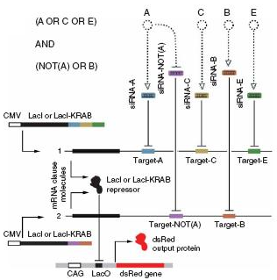
Complicated Logic
Notes:
They also can express more complex logic. Here there are two copies of the gene encoding LacI. The first copy is an OR gate of siRNAs A, C, and E. The second copy is an OR gate of an siRNA inhibited by A and B. The result is the complicated boolean statement (A or C or E) and (not (a) or B).

Slide 7
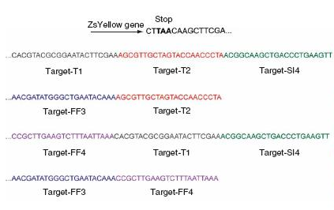
Compact Sequences
Notes:
One nice thing about engineering with siRNA is that the genes are quite small. There are a large number of interactions present in the system, but sequence-wise an interaction only involves a 21 bp sequence in the mRNA.

Slide 8
Scaffolding of Kinase Cascades
PMID 12511654
Notes:
The dynamic crosstalk of signal transduction cascades is a subject of great interest to biologists. At the molecular level, there have been questions about how specificity amongst MAP kinases is determined.

Slide 9
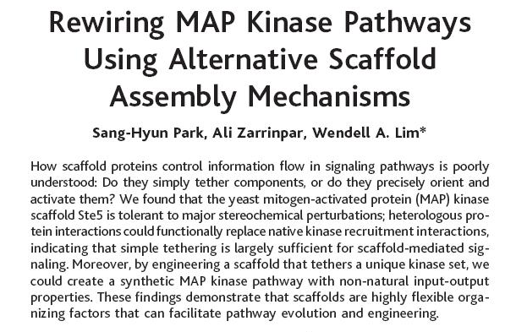
Notes:
In this study, Lim and coworkers demonstrate how the scaffolding of kinase proteins directs phosphorylation amongst a set of kinases.

Slide 10
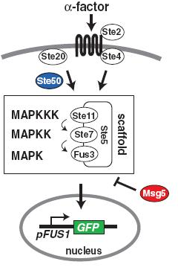
Map Kinase Cascades
The classic view of MAP kinases general leaves out the fact that they often are accompanied by scaffolds
The scaffolds employ protein-protein interactions to recruit a particular set of MAPK’s to a complex
In so doing, the flow of information is directed through a particular set of kinases and doesn’t rely simply on substrate specificity
Lim and co focus on the alpha factor transduction (involved in mating) which is scaffolded by ste5
Notes:
We are accustomed to seeing diagrams that describe a cascade of interactions involving MAP kinases such as Erk. This classic view of MAP kinase cascades general leaves out the fact that they often are accompanied by scaffolds
These scaffolds employ protein-protein interactions to recruit a particular set of MAPK’s into a complex In this diagram, we see three MAP Kinases (ste11, ste7, and fus3) being joined together by the scaffold protein Ste5.
In so doing, the flow of information is directed through a particular set of kinases and doesn’t rely simply on the substrate specificity of protein:protein interactions
This paper focus on alpha factor signal transduction (which is involved in mating) wherein the kinases are scaffolded by ste5 as drawn. With this cascade, signalling with alpha factor results in activation of the kinases and expression of a pFUS1 promoter driving GFP.

Slide 11
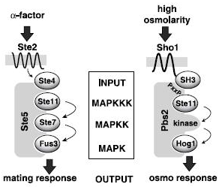
Notes:
This study demonstrates that the scaffold controls the flow of information amongst the kinases by making chimeras of two cascades. Yeast respond to alpha factor with mating response, and to high-osmolarity with an osmo response.

Slide 12
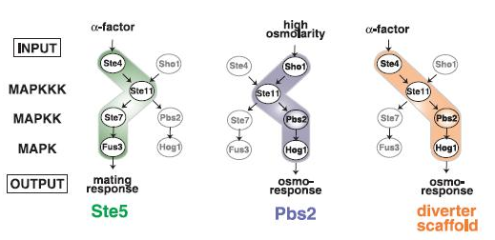
Notes:
The authors show that they can change the responses to these inputs by adding different scaffolds. Addition of the native scaffolds, Ste5 or Pbs2 results in the normal response, but if they add a chimeric ‘diverter scaffold’, they get cells that respond to alpha factor with an osmo response.

Slide 13
Tissue-Specific Expression
PMID: 17385885
Notes:
One of the more interesting things you can do with multicellular organisms is tissue-specific expression.

Slide 14
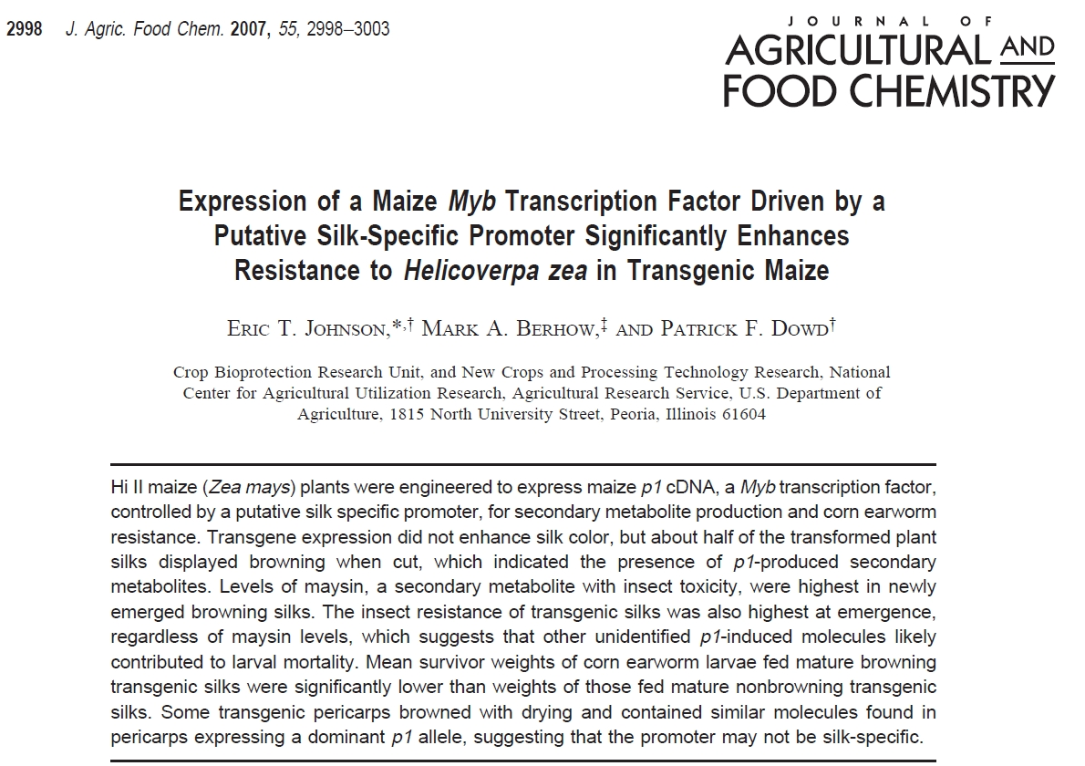
Notes:
In this study, Dowd and coworkers rearrange two DNA sequences found in the Maize genome to create a transgene that activates production of a pesticide in the corn silk.

Slide 15
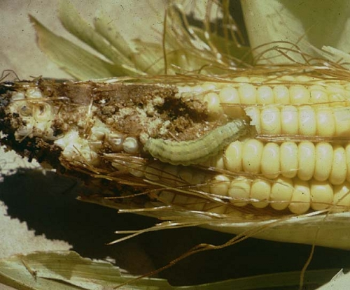
Earworm-resistant corn
Notes:
Earworm is a common infection in corn. One existing solution is the use of Bt transgenes. Here, a gene from a bacillus strain is transferred into the corn, and consumption of the corn by the worm kills them. There have been concerns over the food safety of Bt corn, so researchers have sought more ‘natural’ modifications to plants that don’t require the transfer of foreign genes or restricting the expression of transgenes to non-edible portions of the plant. Only the corn kernels are consumed, so restricting the expression of transgenes to other tissue types is one way of preventing any potential maleffects of expressing foreign proteins in food. In this study, they employ a silk-specific promoter to restrict the expression of downstream genes to just the silk. The downstream gene is a transcription factor that drives production of a compound already in the corn genome able to kill worms. By identifying native genes that can be rewired to produce a desired phenotype researchers can identify plausibly-natural modifications to the organism that can later be achieved through more accepted breeding practices. This study is a clever example of this approach where the design is something that could occur through a natural mutation, and thus in principle could be identified through breeding and genetic screening.

Slide 16
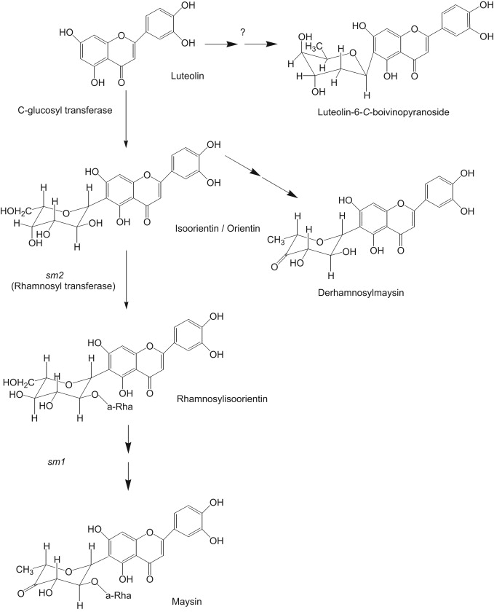
Maysin biosynthesis
Maysin is something some plants make with antibiotic properties
It also kills earworm larvae
p1 encodes a Myb-related transcriptional activator that regulates production of Maysin
Overexpression of p1 accumulates Maysin
Notes:
The anti-earworm compound in their study is Maysin. This flavonoid is natively produced at low levels in corn. At higher concentrations, it is known to kill earworm larvae. Maysin production is regulated by a transcription factor called p1, and it is known that overexpression of p1 in maize results in the accumulation of Maysin.

Slide 17
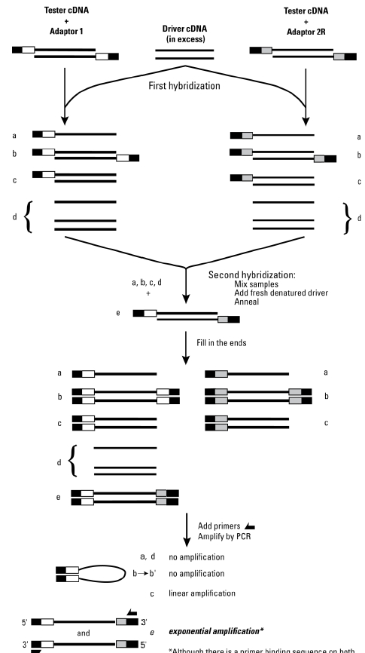
Silk-specific gene pSH64
Patent number: 6392123
Were looking for female-preferential promoters using differential display methods
Isolate mRNA from silk, tassel, leave, and root, make cDNA, then look to see what is overexpressed in specific places
Use Clontech PCR-Select cDNA Subtraction Kit:
This is something highly expressed in silks
(today you’d use RNAseq)
Notes:
They also need a tissue-specific promoter. The notion of ‘tissues’ as a differentiated lineage of cells is a trait unique to multicellular organisms. Typically differentiation involves a wide array of events, but primary within these is differences in gene expression and the emergence of tissue-specific transcription factors. The genetic circuits that control differentiation are often much like the toggle switch in the sense that they are highly multistable circuits with strong reinforcement of one dominant transcription factor. Finding tissue-specific promoters is fairly easy. In this case, for silk, the researchers were looking for female-preferential promoters using differential display methods. They isolated mRNA from silk, tassel, leaves, and roots, converted that RNA to cDNA, then looked to see which genes were preferentially expressed in specific places. Today the tool of choice for such a study would be RNAseq, but that did not exist at the time, so instead they use a clontech pcr-select cDNA substration kit. In essence, this kit has you annealing two cDNA populations to one another, and the method enriches for the differences between the two samples. From this screen, they identify the pSH64 gene as something highly-localized to silks. By cloning out the promoter in front of pSH64, they obtain a promoter part that is specifically activated in silks.

Slide 18
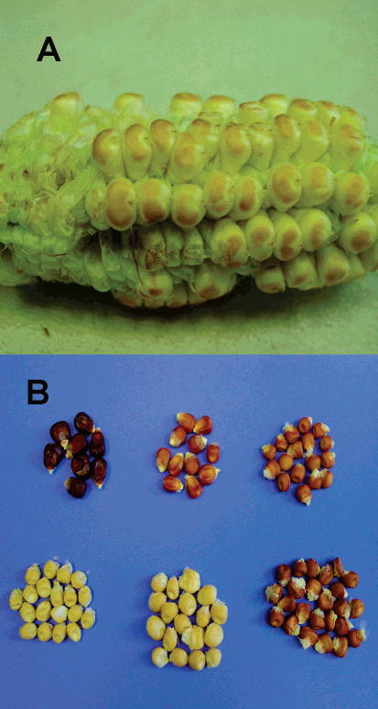
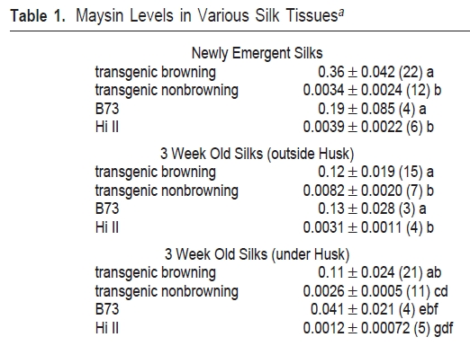
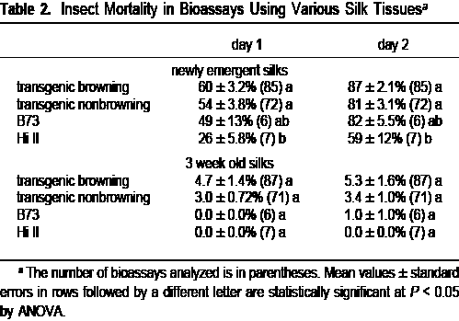
Phenotype
P1-rr
P1-rw
28A x B73
Hi II x B73
15A x B73
7E x B73
Notes:
They now put it together. First they look at the kernals. Here you see 6 strains of corn kernals. Their darkness is an indication of the accumulation of flavonoids in the kernal. More specifically, the flavonoids polymerize into a polymer called phlobaphene that accumulates and is red-colored. As controls, they have two natural alleles of the p1 gene called P1-rr and P1-rw. The rr strain has red pericarp (which is the outermost layer of the kernal) and a red cob. The rw strain has red pericarp and white cob. B73 is the model corn strain whose genome has been sequenced. Hi-II corn is a strain that is amenable to transformation by gold particle bombardment. Thus, they introduce their genes into Hi-II and then pollinate it with B73 pollen, and what they are testing are the resulting hybrid strains. 28A, 15A, and 7E are three isolates of transgenic strain. Each contains an engineered gene in which the p1 cDNA was inserted in between the silk-specific promoter and terminator from pSH64. I’ve put boxes around the three transgenics. Thus, they get different degrees of discoloration from different strains. This is a common theme in eukayotic engineering. The random nature of the genome incorporation methodology give rise to variation in expression levels. Though they employ a tissue-specific promoter, it isn’t entirely off in other tissues. It is not clearly stated in the paper, but let’s assume that the strains they refer to as ‘transgenic browning’ and ‘transgenic nonbrowning’ are 7E and 15A strains respectively.
*
They also examine the silk of these two transgenics and the parent strains. The transgenic browning strains contain the most Maysin, but slighly elevated levels are observed in the transgenic non-browning strain as well (relative to the Hi II parent strain).
*
They also examine insect mortality after being fed the silks, and indeed, both transgenic strains show elevated killing, particularly for young larvae.

Slide 19
Targeting Developmental Phases
PMID 17934737
Notes:
In multicellular organisms, there are distinct tissues that are often distinguishable by characteristic transcription factors. By identifying promoters under the control of these transcription factors, you can restrict a gene’s expression to specific tissues. Additionally, some promoters are only transiently expressed during a particular phase of development allowing temporal restriction of gene expression.

Slide 20
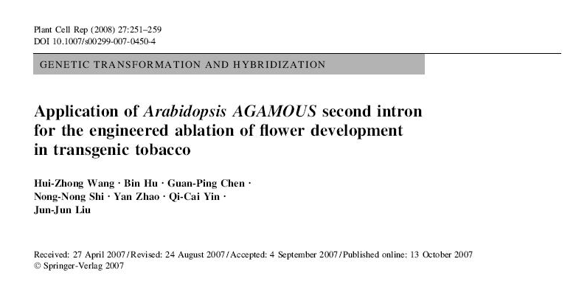
Notes:
In this study, Liu and coworkers employ a transcriptional control element specific to flower development to control a toxic protein’s production. Thus, they can programmatically eliminate flower formation.

Slide 21
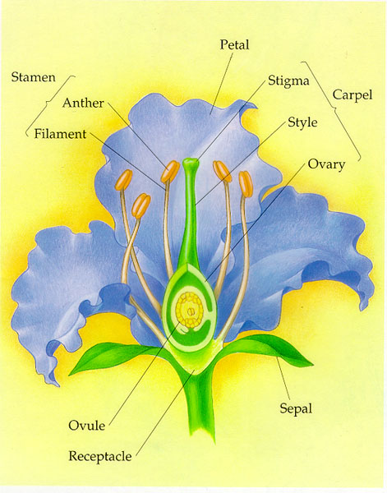

Agamous and Flower Development
AGAMOUS (AG) is a homeotic TF and floral organ identity gene
Functionally similar to Hox genes, but not homologous
Responsible for formation of stamens and carpels in the third and fourth whorls of the wild type flower
Notes:
Homeotic transcription factors are expressed in specific tissue types. AGAMOUS is one of these transcription factors involved in floral organ development. * These plant homeotic transcription factors are functionally similar to Hox genes which define tissue identity in animals, but they are not homologous. Thus these are examples of convergent evolution. * Agamous is involved in the formation of stamens and carpels in the third and fourth whorls of the wild-type flower. During plant flower development, there are layers of tissue within the bud, and each radial layer is termed a whorl. In a flower like a rose, the number of whorls is uncontrolled, but in most flowers there are a defined number of these whorls.

Slide 22
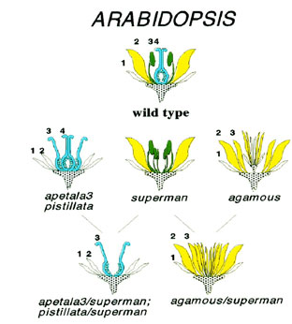
Agamous and Flower Development
AGAMOUS (AG) is a homeotic TF and floral organ identity gene
Functionally similar to Hox genes, but not homologous
Responsible for formation of stamens and carpels in the third and fourth whorls of the wild type flower
ag mutant flowers produce an endless number of floral whorls, repeating the basic pattern: (sepal, petal, petal)n.
AG RNA begins to accumulate in stage 3 flowers in cells that will later give rise to stamens and carpels.
Later in flower development, AG RNA continues to develop in stamens and carpels but becomes restricted to specific cell types
Notes:
In arabidopsis, these whorls differentiate into distinct portions of the flower such as staments, petals, and sepals. ag mutants of the AGAMOUS gene produce flowers with an endless number of floral whorls, repeating the basic pattern: (sepal, petal, petal). As shown in the figure, there are many other flower phenotypes that can result from mutation of homeotic transcription factors. * AGAMOUS RNA begins to accumulate in flower cells that will later give rise to stamens and carpels. * Later in flower development, AG RNA continues to develop in stamens and carpels but becomes restricted to specific cell types. Thus, AGAMOUS is a primarily a transiently expressed product whose most prominent role is during early phases of flower development.

Slide 23
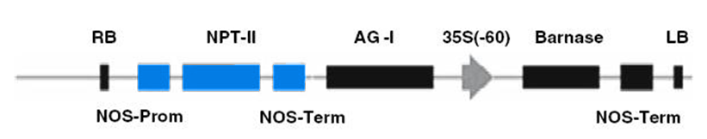
What they made
They insert a barnase (very toxic bacterial Rnase) into the agamous gene to get cell type-specific expression of barnase in flower sex organs
Proposed as a strategy for preventing the dissemination of transgenes in the environment by creating sterility
Neomycin resistance gene
agamous second intron
T-DNA targetting
T-DNA targetting
Cauliflower mosaic virus promoter
Constitutive promoter
terminator
terminator
Notes:
The authors put barnase (which is a potent bacterial RNase) under the control of the agamous gene’s regulation to get cell type-specific expression of barnase in flower sex organs. This is proposed as a strategy for preventing the dissemination of transgenes in the environment by creating sterility. The gene structure they constructed is somewhat unusual. On the ends, there are targeting sites for a transposase. This is used to transfer the cassette into the plant genome. There is a normal-looking antibiotic resistance marker, and then the barnase cassette. What is unusual is that the regulatory element being taken from agamous is the second intron, not a 5’ upstream promoter sequence. That intron is placed upstream of a virally-derived promoter, then the barnase and terminator.

Slide 24
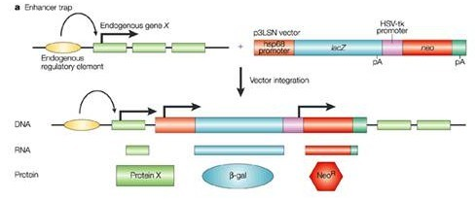
How does that work?
The CaMV 35S promoter (–60) is a minimal promoter—it alone is not sufficient for transcription
It is used for “enhancer trap” experiments to clone (by fusion upstream) DNAs encoding enhancer elements
The agamous enhancers are located in the second intron, not the 5’ UTR
So, this is transcriptional control
Notes:
The unusual gene structure is due to the means by which the transcriptional control element is defined. It is part of an ‘enhancer trap’ experiment. The promoter they employ, the CAMV 35S promoter, is a minimal promoter that alone is not sufficient for transcription. It has binding sites for an activator, but without the addition of enhancer elements little transcription results. Because enhancers act over long distances through looping the DNA and binding to other sites of Mediator, it these elements can often be placed at arbitary positions near a gene and still have the desired effect. In the enhancer trap experiment, the CaMV promoter is placed upstream of a selectable marker or reporter gene. In the illustration, that reporter gene is lacZ allowing blue/white screens. A library of genetic elements, usually from fragmentation of a larger gene cassette, is cloned upstream of the reporter construct, and then variants are screened for tissue-specific phenotypes. From such a screen, it was determined that the second intron contained the enhancer elements that define its tissue localization. Though it is in an intron, this is transcription initiation control not some form of splicing or termination control.

Slide 25
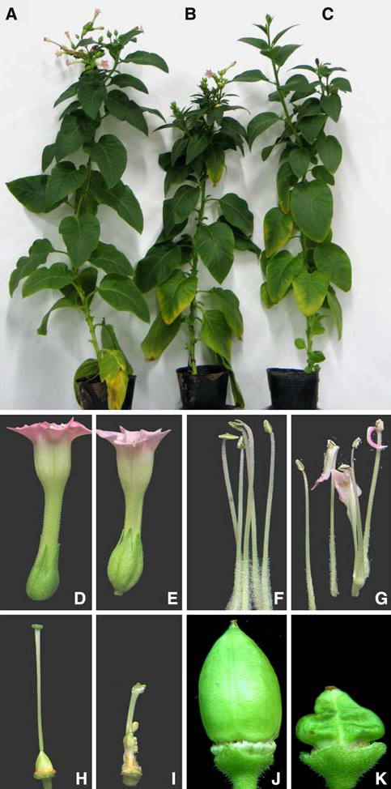
What do they get?
T-DNA is essentially a transposon, you get random integration
Different integration sites give different behavior
Some of their strains give the desired phenotype
Morphology of the entire plant is normal
Get abnormal flowers with normal petals and stamens but messed up stamens and carpels
Fruits are also mutilated
Still get pollen, but it’s less viable
Still get seeds that are viable from all this, but about 1 order of magnitude down in viability
Notes:
They introduce their DNA into cells via transposition, and as a result it inserts into distinct loci.
Different integration sites give different behavior
By screening multiple plants they find some strains that give the desired phenotype – the production of aberrant flowers.
In these mutants, the Morphology of the entire plant is normal
The flowers have normal petals and stamens but the stamens and carpels are damaged or absent as predicted
The morphology of the fruits is also aberrant, but they still get made
The plant still produces pollen, but it’s morphologically and functionally damaged
The plants also produce seeds that are viable, but their viability in the production of new plants is about 1 order of magnitude reduced

